Slide 1
Chemical bond
Chemical Bond: A chemical bond is a lasting attraction between atoms, ions or molecules that enables the formation of chemical compounds. Chemical bonds form when two atoms approach each other and the attractive forces are greater than the repulsive forces.
Principles of Electronic Theory of Chemical Bonding:
Chemical combination between atoms of the same or different element takes place due to the tendency by the outermost electron groups to attain the stable arrangement of inert gases.
The attainment of inert gas electron configuration may take place by complete transference of electrons from one atom to another. The resulting electrically charged atoms (or ions) are held together by electrostatic force of attraction. The chemical bond so formed is known as electrovalent or ionic bond.
The attainment of inert gas configuration may occur by sharing of electrons (in pairs) between two atoms. The chemical bond so formed in called covalent bond.
The attainment of electron groupings of inert gases may also happen by both transference and sharing of electrons between atoms in pairs. The bond so formed is known as coordination bond.
Ionic bond: The ionic bond is formed when one or more electrons are transferred from one atom to other to complete the orbitals in each case. In both case, the electronic arrangement of the resulting ions is identical to that of an atom of one of the inert gases.

Slide 2
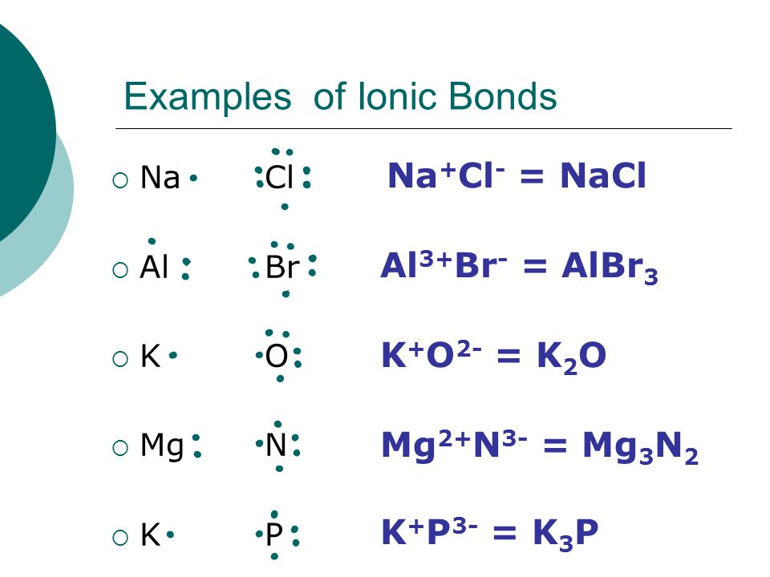
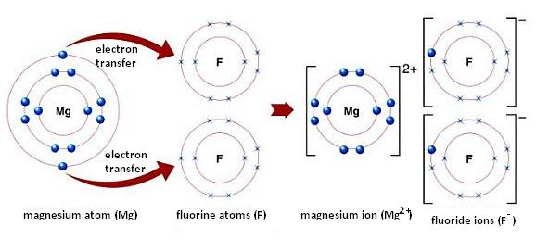
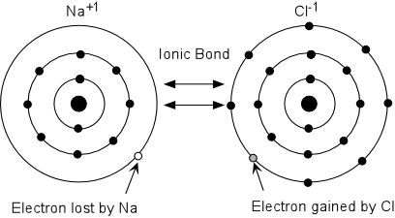
Examples of Ionic bond

Slide 3
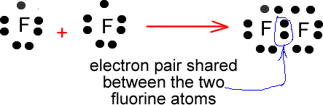
Covalent bond:
Lewis Theory: Atoms may combine with each other chemically by sharing of electrons. A chemical bond of this type is called a covalent bond, and compounds containing these bond are called covalent compounds. This type of chemical bond was first suggested by G. N. Lewis in 1916.
Generally, non-metals form this type of bond. This bond is denoted by (-). The compounds having covalent bond are called covalent compounds. For example: formation of HCl, H2O, CO2, NH3 molecules.
For example, fluorine molecule is formed by combination of two fluorine atoms. Fluorine atom having electron arrangement of 1s²2s²2p⁵ has one electron less than the neon atoms , 1s²2s²2p⁶ . Hence if two fluorine atoms combine, one electron from each atoms is paired up atoms is shared in common by both the atoms to produce the stable electronic arrangement of neon for the two fluorine atoms.

Slide 4
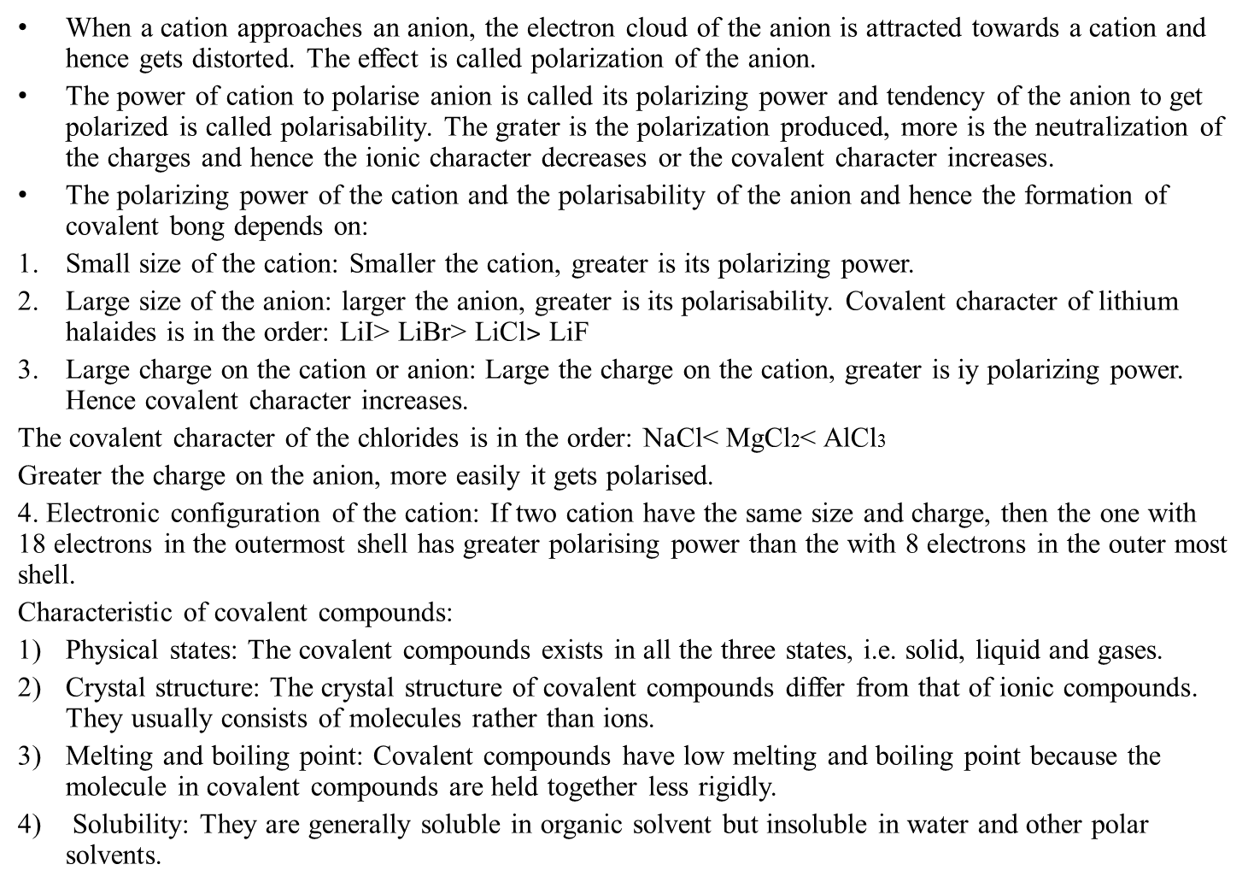
Fajan’s Rule
When a cation approaches an anion, the electron cloud of the anion is attracted towards a cation and hence gets distorted. The effect is called polarization of the anion.
The power of cation to polarise anion is called its polarizing power and tendency of the anion to get polarized is called polarisability. The grater is the polarization produced, more is the neutralization of the charges and hence the ionic character decreases or the covalent character increases.
The polarizing power of the cation and the polarisability of the anion and hence the formation of covalent bong depends on:
Small size of the cation: Smaller the cation, greater is its polarizing power.
Large size of the anion: larger the anion, greater is its polarisability. Covalent character of lithium halaides is in the order: LiI˃ LiBr˃ LiCl$˃$ LiF
Large charge on the cation or anion: Large the charge on the cation, greater is iy polarizing power. Hence covalent character increases.
The covalent character of the chlorides is in the order: NaCl< MgCl2< AlCl3
Greater the charge on the anion, more easily it gets polarised.
4. Electronic configuration of the cation: If two cation have the same size and charge, then the one with 18 electrons in the outermost shell has greater polarising power than the with 8 electrons in the outer most shell.
Characteristic of covalent compounds:
Physical states: The covalent compounds exists in all the three states, i.e. solid, liquid and gases.
Crystal structure: The crystal structure of covalent compounds differ from that of ionic compounds. They usually consists of molecules rather than ions.
Melting and boiling point: Covalent compounds have low melting and boiling point because the molecule in covalent compounds are held together less rigidly.
Solubility: They are generally soluble in organic solvent but insoluble in water and other polar solvents.

Slide 5
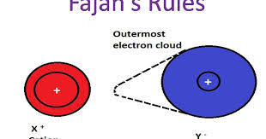
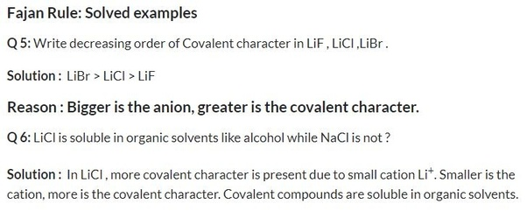
Fajan’s Rule
5). Electrical conductivity: Since there are no free ions in covalent compounds to conduct electricity, they are bad conductors of electricity.
6). Non-ionic reaction: These compounds are molecular in nature and not ionic, their reactions are molecular and proceed at a much slower rate than those of ionic compounds.

Slide 6
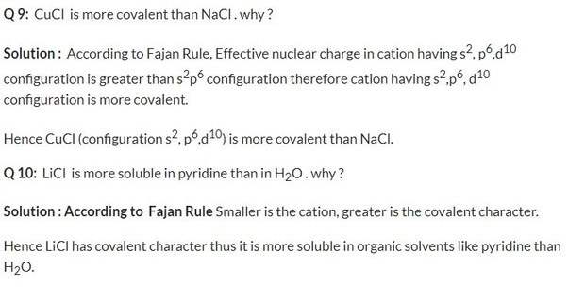
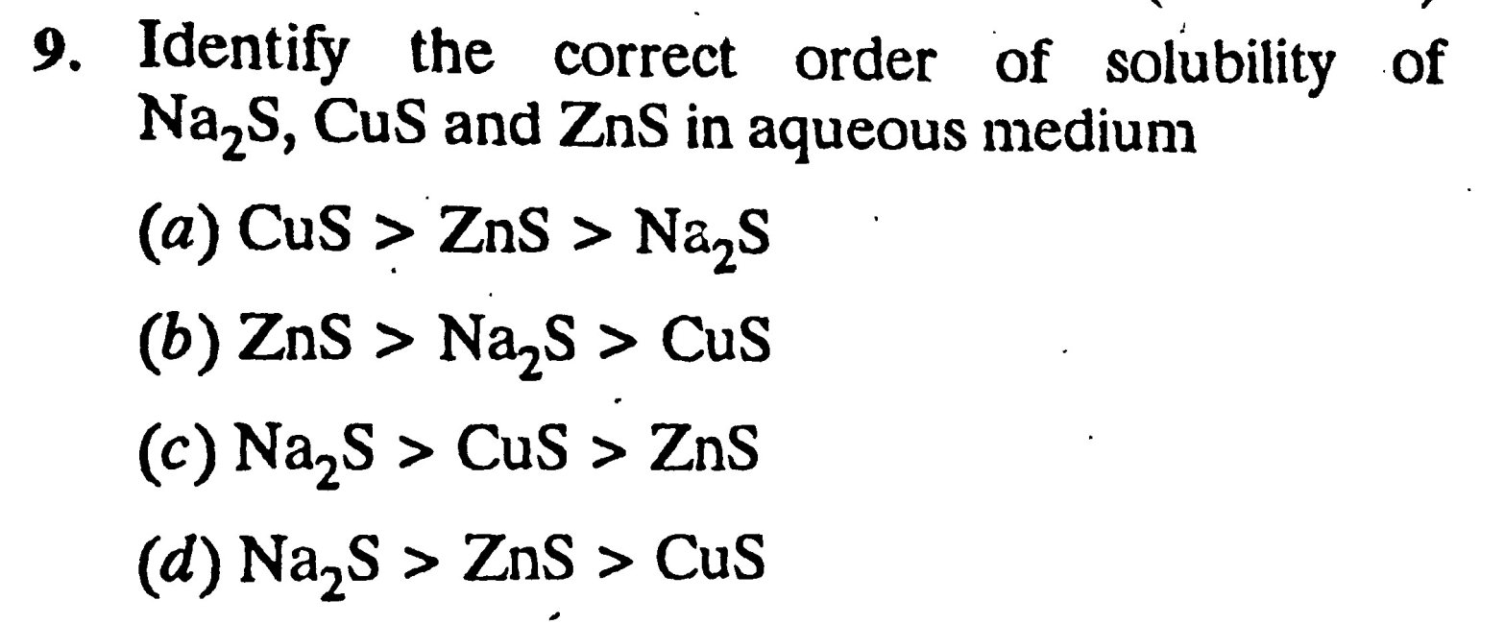

Slide 7
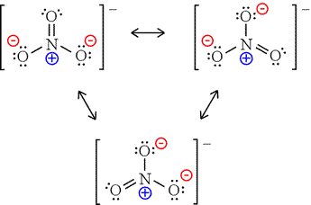
Lewis dot structure
How to draw Lewis Diagrams
An outline of how to detemine the "best" Lewis structure for an example, NO₃⁻ is given below:
1. Determine the total number of valence electrons in a molecule
N 5
3 O 18
For 1 electron 1
Total= 24
2. Draw a skeleton for the molecule which connects all atoms using
only single bonds. In simple molecules, the atom with the most
available sites for bondng is usually placed central. The number of
bonding sites is detemined by considering the number of valence
electrons and the ability of an atom to expand it's octet. As you
become better, you will be able to recognise that certain groups of
atoms prefer to bond together in a certain way.
3. Of the 24 valence electrons in NO₃⁻, 6 were required to make the skeleton. Consider the remaining 18 electrons and place them so as to fill the ocets of as many atoms as possible (start with the most electronegative atoms first then proceed to the more electropositive atoms).
4. Are the octets of all the atoms filled? If not then fill the remaining octets by making multiple bonds (make a lone pair of electrons, located on a more electronegative atom, into a bonding pair of electrons that is shared with the atom that is electron defficient).
5. Check that you have the lowest formal charge possible for all the atoms, without violating the octet rule; (valence e-) - (1/2 bonding e-) - (lone electrons).
6. You may find that the best Lewis diagram (the one with the lowest formal charges and all octets satisfied) is given in a number of different ways. For NO₃⁻, three different diagrams are given below. From left to right they start with the most complete Lewis diagram to the most simplified

Slide 8
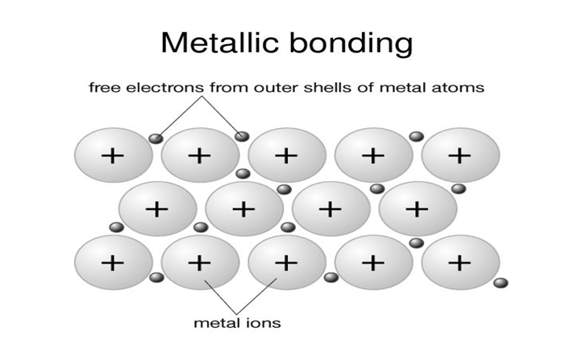
Metallic bond
The peculiar type of boding which hold the atoms together in metal crystal is called the metallic bodings.
Occurs between like atoms of a metal in the free state
Valence e- are mobile (move freely among all metal atoms)
Positive ions in a sea of electrons
Metallic characteristics
High mp temps, ductile, malleable, shiny
Hard substances
Good conductors of heat and electricity as (s) and (l)

Slide 9
THE ELECTRON SEA MODEL
Metal atoms are characterized by :
(1) Low ionization energies which imply that the valence electrons in metal atoms can easily be separated.
(2) A number of vacant electron orbitals in their outermost shell. For example, the magnesium atom with the electron configuration 1s² 2s² 2p6 3s2 3p0 has three vacant 3p orbitals in its outer electron shell.
There is considerable overlapping of vacant orbitals on one atom with similar orbitals of adjacent atoms, throughout the metal crystal. Thus it is possible for an electron to be delocalized and move freely in the vacant molecular orbital encompassing the entire metal crystal. The delocalized electrons no longer belong to individual metal atoms but rather to the crystal as a whole. As a result of the delocalization of valence electrons, the positive metal ions that are produced, remain fixed in the crystal lattice while the delocalized electrons are free to move about in the vacant space in between. The metal is thus pictured as a network or lattice of positive ions of the metal immersed in a ‘sea of electrons’ or ‘gas of electrons’. This relatively simple model of metallic bonding is referred to as the Electron Sea model or the Electron Gas model (Fig. Previous page.)

Slide 10
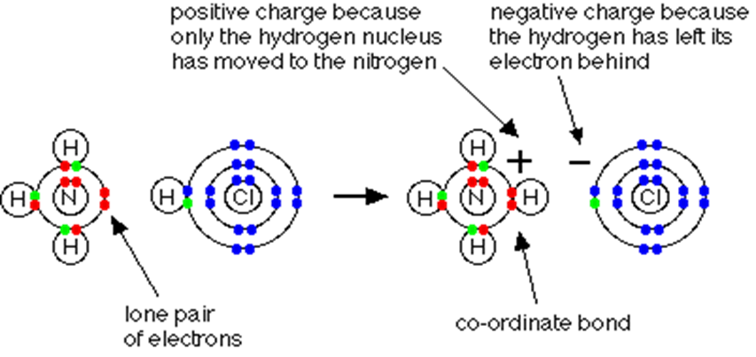
Coordination bond
Langmuir theory:
In some molecule one of the atoms may supply both electrons, i. e., both the shared electrons come from the same atom. A covalent bond formed by the donation of a pair of electrons from one atom to another atom in the molecule is called a coordination bond.
The reaction between ammonia and hydrogen chloride
If these colorless gases are allowed to mix, a thick white smoke of solid ammonium chloride is formed.
Ammonium ions, NH4+, are formed by the transfer of a hydrogen ion from the hydrogen chloride to the lone pair of electrons on the ammonia molecule.

Slide 11
When the ammonium ion, NH4+, is formed, the fourth hydrogen is attached by a dative covalent bond, because only the hydrogen's nucleus is transferred from the chlorine to the nitrogen. The hydrogen's electron is left behind on the chlorine to form a negative chloride ion.
Once the ammonium ion has been formed it is impossible to tell any difference between the dative covalent and the ordinary covalent bonds. Although the electrons are shown differently in the diagram, there is no difference between them in reality.
Donor-acceptor atoms: In the above case since nitrogen atom supplies or donates both the electrons to form a coordination bond, it is known as donor atoms. The electrons to form a coordination bond, it is known as acceptor atom. the bond between the donor and the acceptor atoms constitutes the coordination bond.
Two condition are necessary for the formation of this type of bond:-
One atom, molecule or ion must have an electron pair available for sharing with other atom by donation.
(2) One atom, molecule or ion must be capable of sharing the lone pair of electrons by acceptance

Slide 12
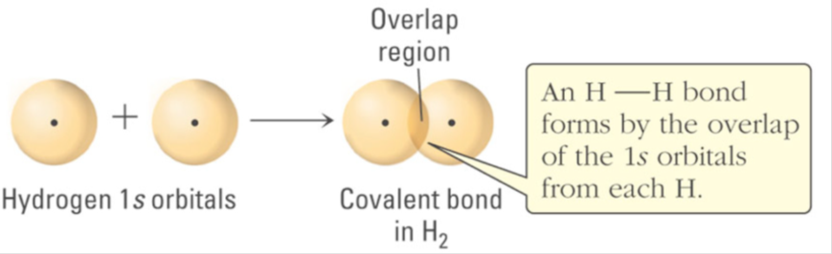
Valence-bond theory
The basic tenets of valence bond (VB) theory are
valence atomic orbitals on adjacent atoms overlap,
each pair of overlapping valence orbitals is occupied by two valence electrons to form a chemical bond, and
valence electrons are either involved in bonding between two atoms (shared bonding pairs) or reside on a single atom (nonbonding lone pairs).
A covalent bond is the result of the overlap of orbitals on adjacent atoms. The bonding region is the location between the atomic nuclei, where electrons occupy the overlapping orbitals. For example, consider the covalent bond in hydrogen, H₂
Each H atom has a single unpaired electron in a 1s orbital. The covalent bond in H2 is the result of the overlap of two 1s atomic orbital on adjacent H atoms, and each H atom contributes one electron to the covalent bond. The covalent bond forms because of the strong attractive forces between the bonding electrons in the overlapping region and the two H nuclei.

Slide 13
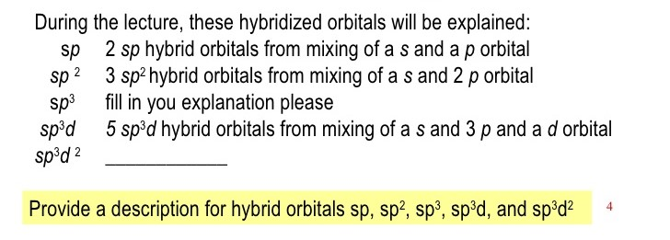
Conditions for the combinations of atomic orbitals
There are certain conditions for the combination of atomic orbitals which may be stated, in short, as follow:
The orbitals must have similar energies.
The orbitals must overlaps to a considerable extent.
The orbitals must possess the same symmetry about the molecular axis.
According to Pauli Exclusion Principle, each bonding orbitals contains two electrons of opposed spin.
What is hybridization?
Mixing of two or more atomic orbitals to form new hybrid orbitals.

Slide 14
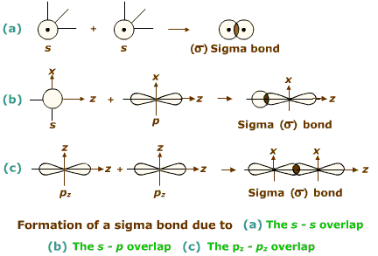
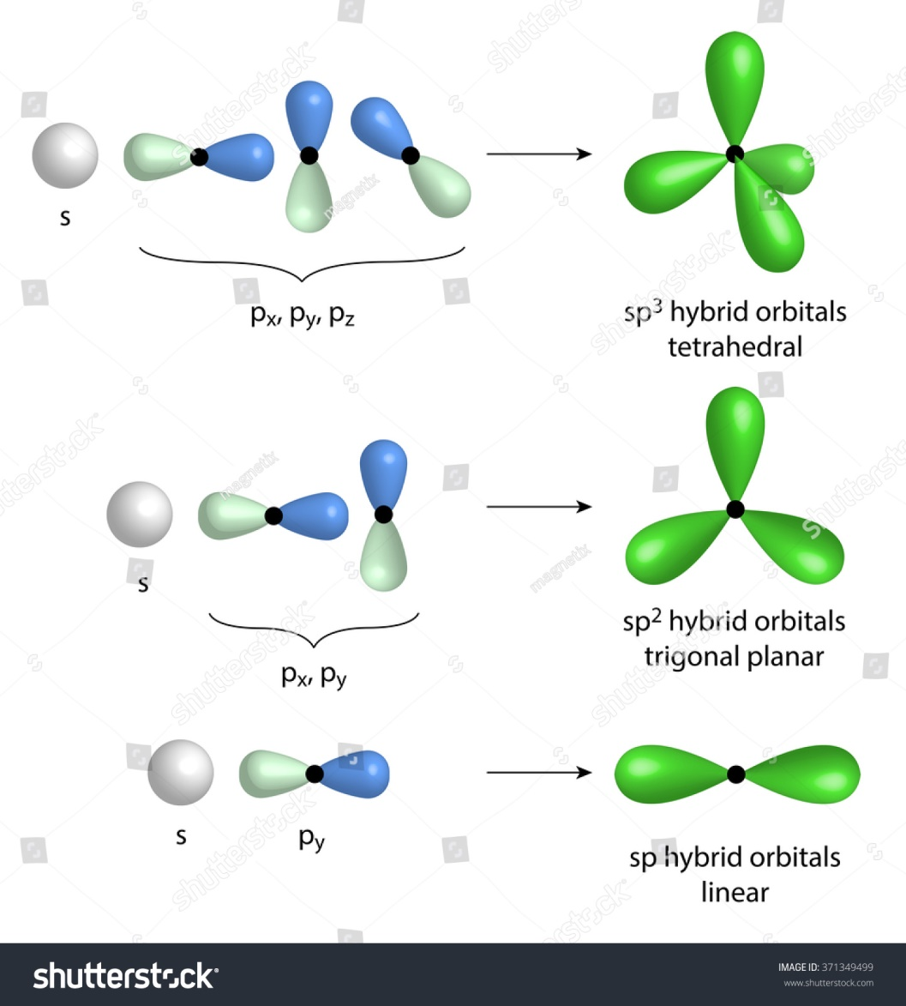
Hybridization

Slide 15
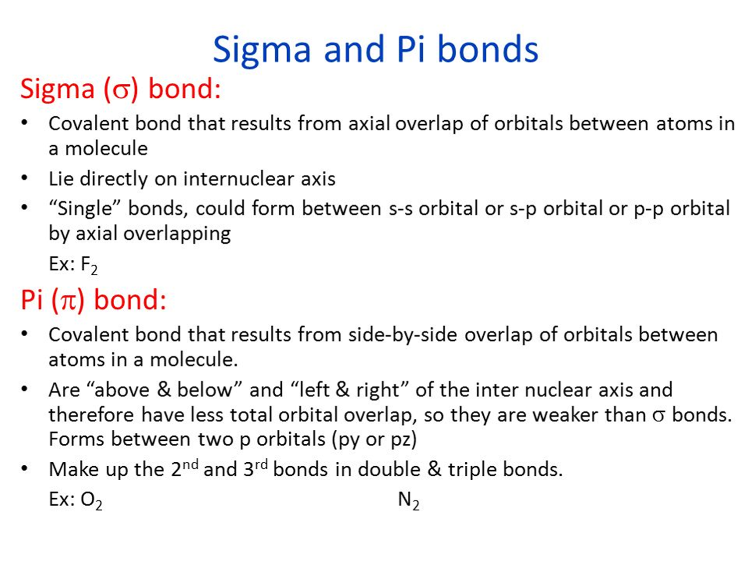

Slide 16
What is the difference between sigma and pi bond?
Sigma (σ) bond | Pi (π) bond
1. It is formed by end to end overlapping of half filled atomic orbitals. | 1. It is formed by the sidewise overlapping of half filled p-orbitals only.
2. Overlapping takes place along internuclear axis. | 2. Overlapping takes place perpendicular to internuclear axis.
3. The extent of overlapping is large and bond formed is stronger. | 3. The extent of overlapping is small and bond formed is weaker.
4. There is free rotation about σ bond | 4. There is no free rotation about π bond
5. The bond can be present alone. | 5. The bond is always formed in addition to sigma (σ) bond.
6. s and p orbitals can participate in the formation of σ bond. | 6. Only p-orbitals participate in the formation of π bond.

Slide 17
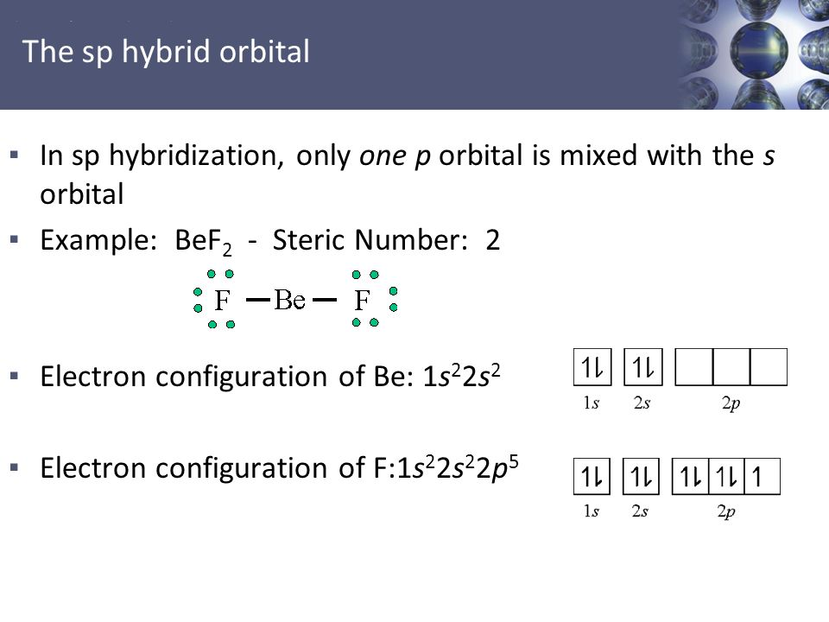
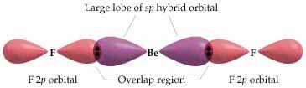
Q. Explain SP Hybridization
with example?
Or Explain structure of BeF2
or BeCl2
With valence bond theory?

Slide 18
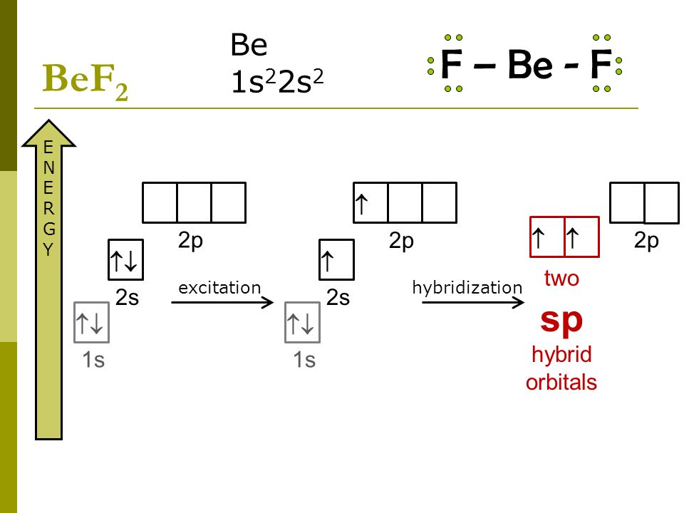
SP hybridization of BeF2

Slide 19
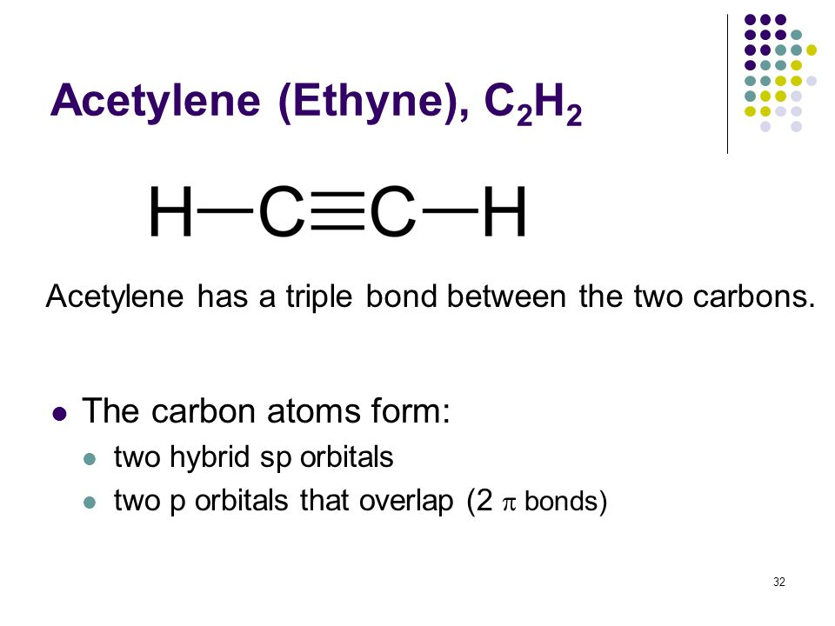
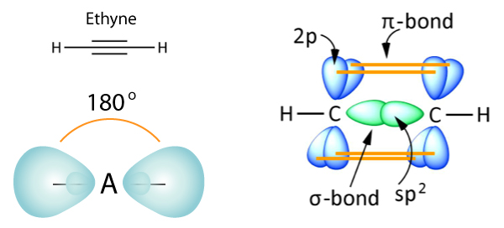
SP hybridization of C2H2
Draw atomic orbital diagram of C2H2 and denote hybridization, σ and π bond?

Slide 20
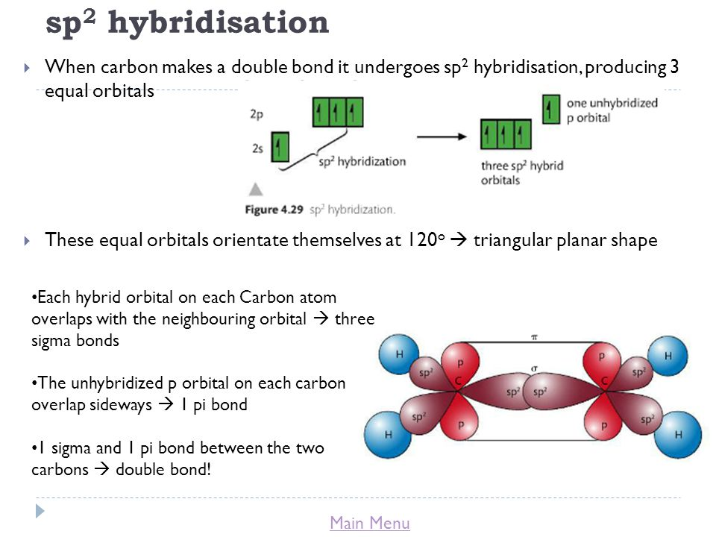

Slide 21
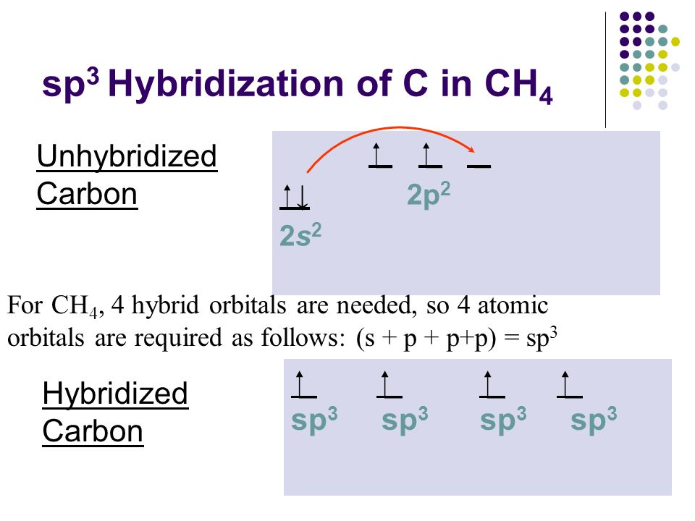
SP³ hybridization

Slide 22
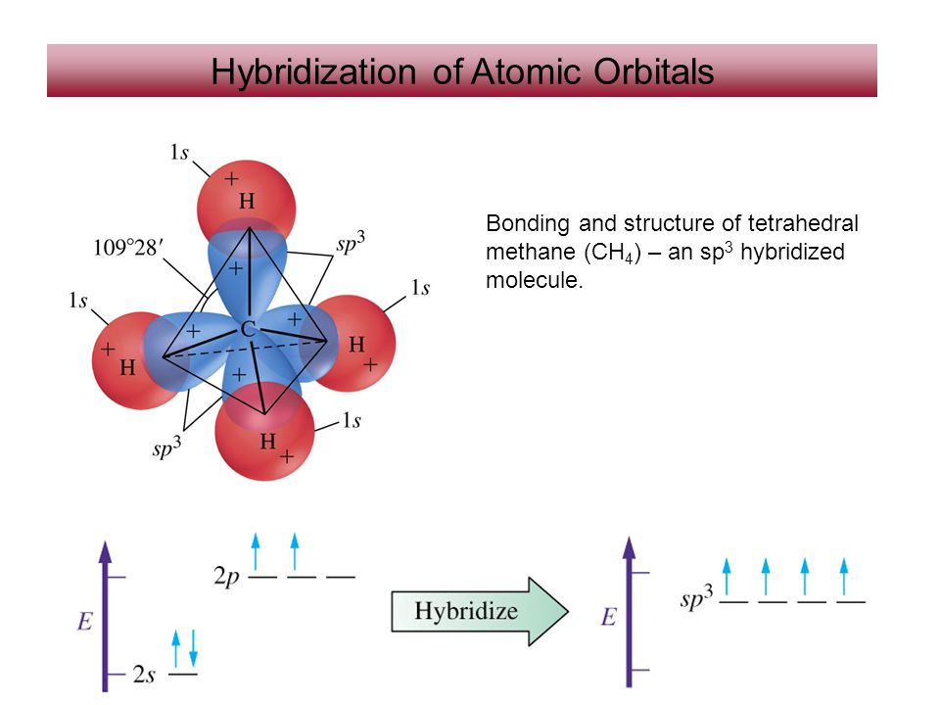

Slide 23
1. What is the orbital hybridization of t a central atom that has one lone pair and bonds to A) two other atoms? B) three other atoms? C) four other atoms? D) five other atoms?
2. What is the hybridization of the chlorine atom in each of the following polyatomic ions:
A) ClO2 - B) ClO3 - C) ClO4 -
3. Is this statements true or false: Two Ω-bonds comprise a double bond. A) True B) False
4. Is this statements true or false: A triple bond consists of one π-bond and two Ω-bonds. A) True B) False
5. Is this statements true or false: A π bond consists of two pairs of electrons. A) True B) False

Slide 24
What is VSEPR Theory??
Valence shell electron pair repulsion (VSEPR) theory is a model used in chemistry to predict the geometry of individual molecules from the number of electron pairs surrounding their central atoms The premise of VSEPR is that the valence electron pairs surrounding an atom tend to repel each other and will, therefore, adopt an arrangement that minimizes this repulsion, thus determining the molecule's geometry.
VSEPR theory is used to predict the arrangement of electron pairs around non-hydrogen atoms in molecules, especially simple and symmetric molecules, where these key, central atoms participate in bonding to two or more other atoms; the geometry of these key atoms and their non-bonding electron pairs in turn determine the geometry of the larger whole.
The number of electron pairs in the valence shell of a central atom is determined after drawing the Lewis structure of the molecule, and expanding it to show all bonding groups and lone pairs of electrons In VSEPR theory, a double bond or triple bond are treated as a single bonding group. The sum of the number of atoms bonded to a central atom and the number of lone pairs formed by its nonbonding valence electrons is known as the central atom's steric number.

Slide 25
The electron pairs (or groups if multiple bonds are present) are assumed to lie on the surface of a sphere centered on the central atom and tend to occupy positions that minimize their mutual repulsions by maximizing the distance between them. The number of electron pairs (or groups), therefore, determines the overall geometry that they will adopt. For example, when there are two electron pairs surrounding the central atom, their mutual repulsion is minimal when they lie at opposite poles of the sphere. Therefore, the central atom is predicted to adopt a linear geometry. If there are 3 electron pairs surrounding the central atom, their repulsion is minimized by placing them at the vertices of an equilateral triangle centered on the atom. Therefore, the predicted geometry is trigonal. Likewise, for 4 electron pairs, the optimal arrangement is tetrahedral
**** The least repulsion is between two bond pairs
The greatest repulsion is between two lone pair
And in between one lone pair and one bond pair electrons

Slide 26
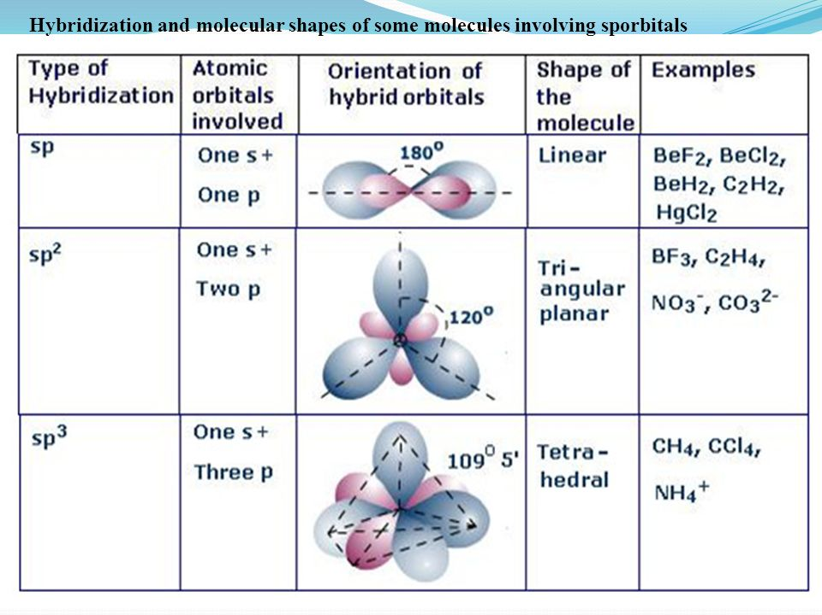

Slide 27
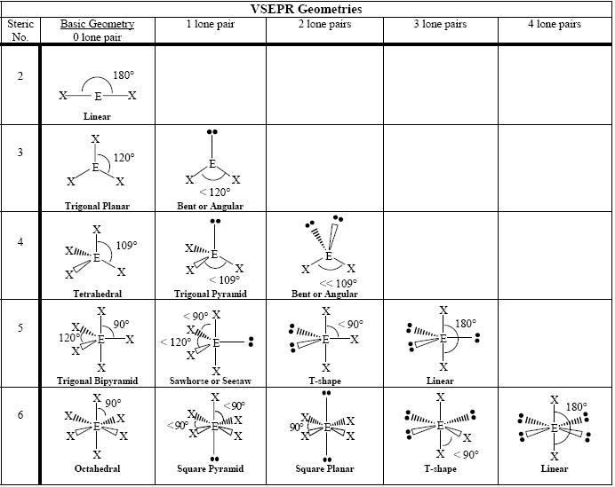

Slide 28
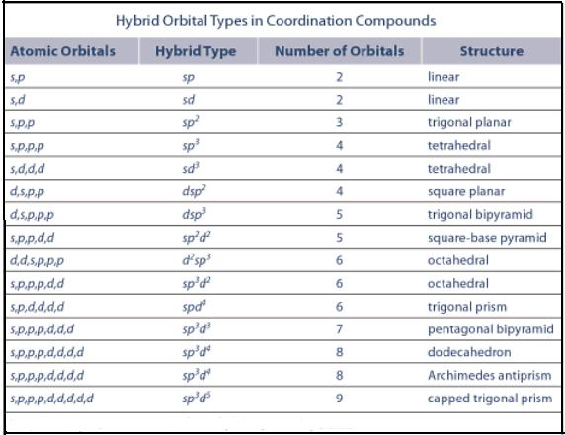

Slide 29
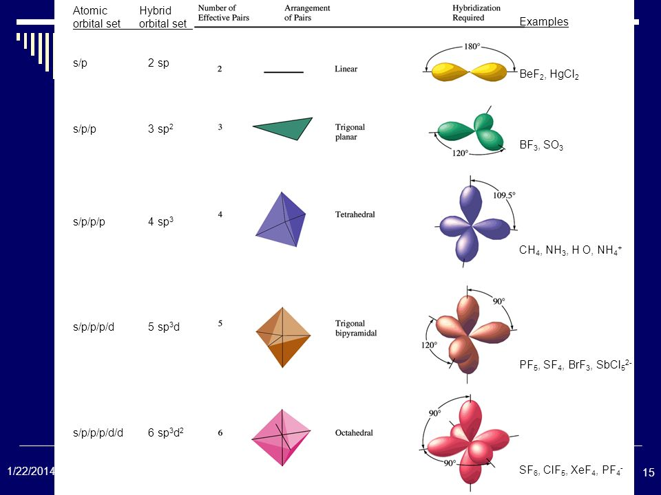

Slide 30
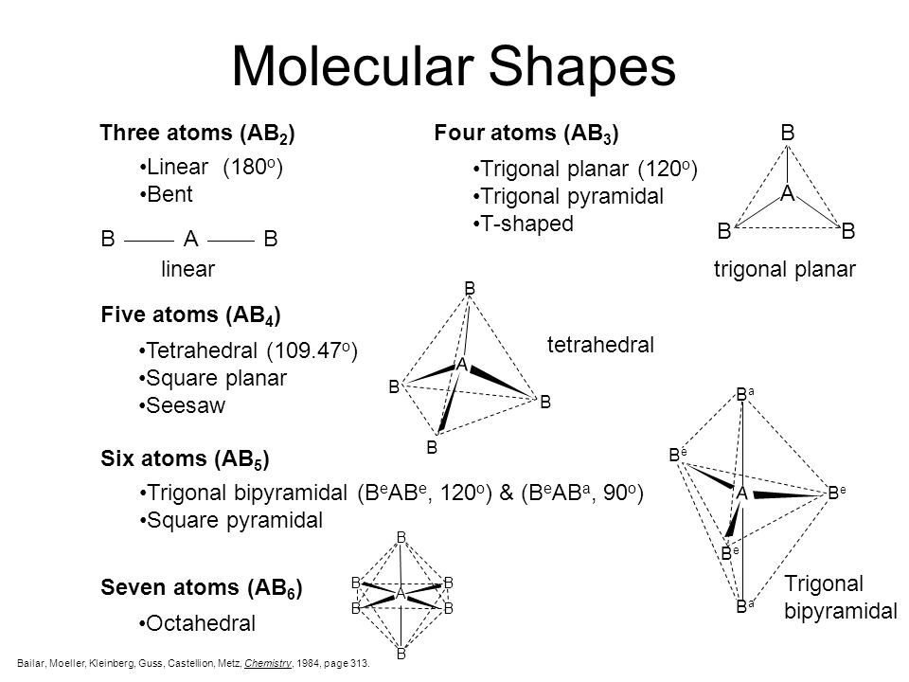

Slide 31
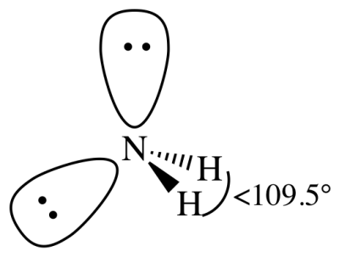
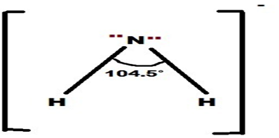
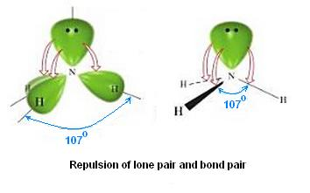
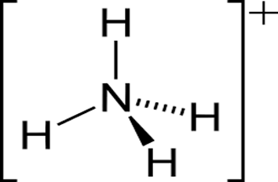
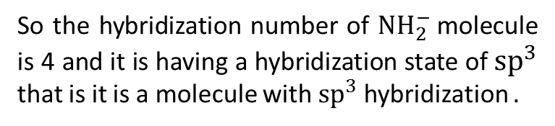

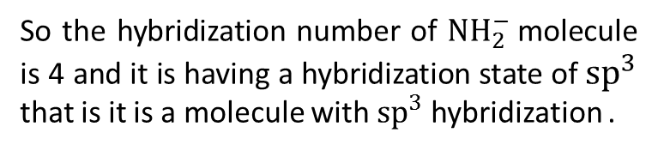

What is the hybridization of N in NH2-, NH3 and NH4+
For ${NH}_{2}^{−}$
H = ½(V+M±C)
H=1/2(5+2+1)
H=8/2=4
So the hybridization number of ${NH}_{2}^{−}$molecule is 4 and it is having a hybridization state of ${sp}^{3}$ that is it is a molecule with ${sp}^{3}$ hybridization .
For${ NH}_{4}^{+}$
H = ½(V+M±C)
H=1/2(5+4-1)
H=8/2=4
So the hybridization number of ${NH}_{2}^{−}$molecule is 4 and it is having a hybridization state of ${sp}^{3}$ that is it is a molecule with ${sp}^{3}$ hybridization .

Slide 32
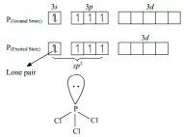
Explain bonding in PCl3 molecule according to valence bond theory.
The hybridization number of a molecule can be calculated according to the formula -
H = GA + (VE - V - C)/2 ,
where H denotes the hybridization number , GA denotes the group atoms attached to the central atom , VE denotes the valence electrons of the central atom , V denotes the valency of the central atom and C denotes the charge over the molecule .
In PCl3 , the central atom is Phosphorus and three chlorine atoms are attached to phosphorus atoms , so the group atoms attached is 3 , the valence electrons present in ground state of phosphorus atom is 5 . It is attached to three chlorine atoms by means of single covalent bonds , so its valency is 3 . The molecule is neutral as a whole so charge present over the molecule is 0 . Putting the values , we get
H = 3 + (5 - 3 - 0)/2
H = 3 + 2/2
H = 3 + 1=4
So the hybridization number of PCl3 molecule is 4 and it is having a hybridization state of sp3 that is it is a molecule with sp3 hybridization .

Slide 33
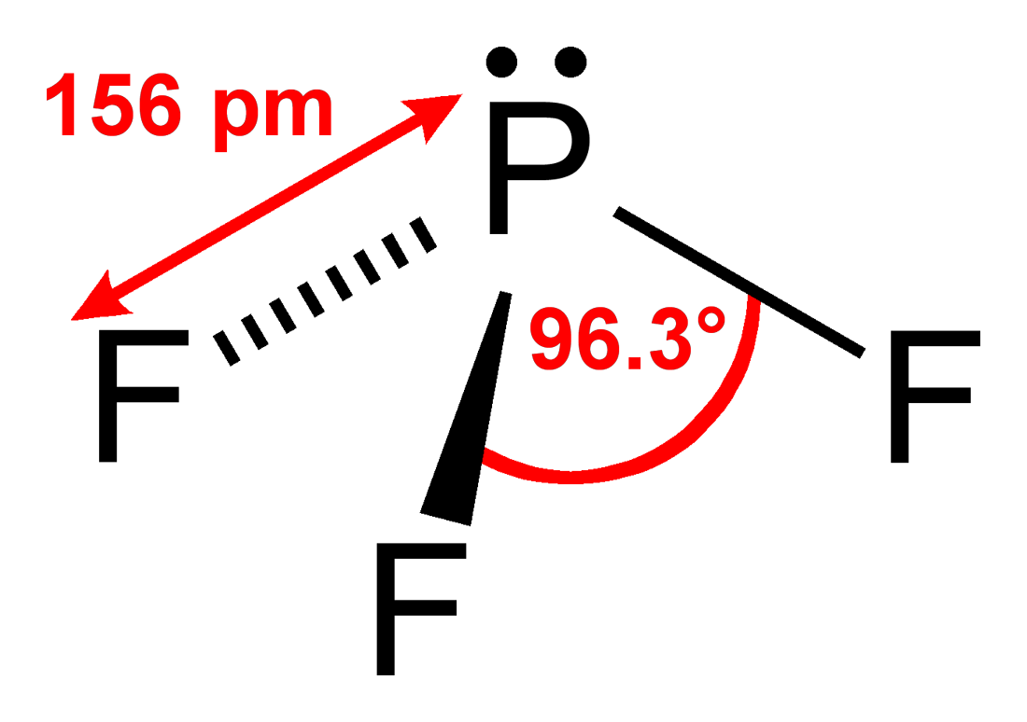
PF3 is a trigonal pyramidal molecule, Explain.
VESPR stands for valence shell electron pair repulsion. This theory basically says that bonding and non-bonding electron pairs of the central atom in a molecule will repel (push away from) each other in three dimensional space and this gives the molecules their shape.
We can use the following notations when examining a Lewis structure of a molecule. A = central atom X = peripheral atoms E = non-bonding electron pairs of the central atom
AX2 = linear molecule AX3 = trigonal planar AX3E = trigonal pyramidal AX2E2 = bent AX4 = tetrahedral molecule

Slide 34
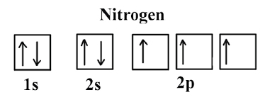
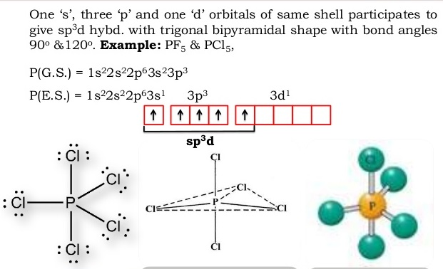
PCl5 exists but NCl5 does not, why?
Nitrogen is a 2nd period element which no vacant d-orbital whereas Phosphorus is the element of 3rd period which has vacant d-orbital. Hence Phosphorus can form bonds with 5 Chlorine atoms but Nitrogen can't.

Slide 35

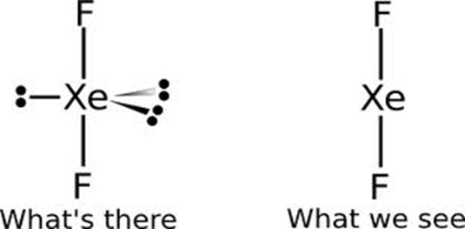
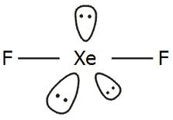
XeF2 is a linear molecule
Here are 22 electrons in the molecule that are valence electrons. The 3 pairs of electrons are there on each fluorine atom as shown in the figure, which form the octet structure along with the bonded pair between them and central Xe atom. Thus there are a total of 8 pairs. The remaining 3 lone pairs on Xe atom as shown in the figure completes the 11 pairs.
These are arranged in trigonal bi pyramid molecular geometry. The three non bonded pair of electrons prefer the equatorial position. The bonded pair of electrons take the apical position of the trigonal bi pyramid and hence the molecule is linear.
The molecule is termed as linear because the bonded pairs cannot move around the central Xenon atom but the lone pairs can move. In spectroscope these lone pairs appear like a cloud.

Slide 36
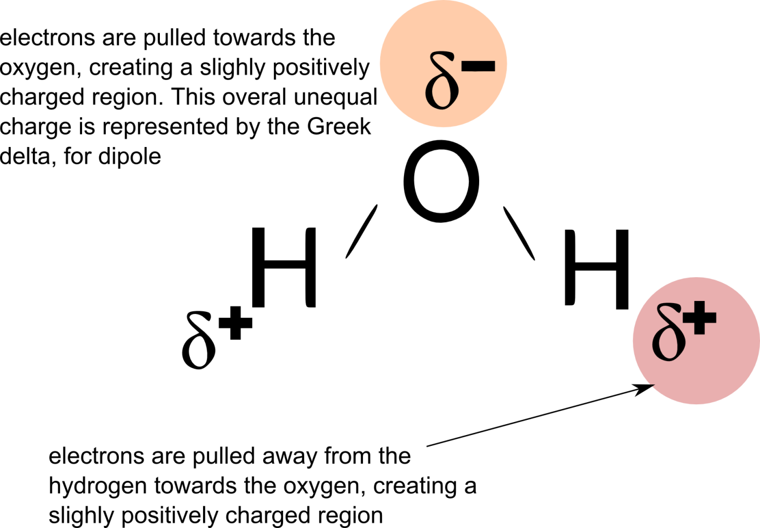
Why water molecule is v/bent shaped??
Water is composed of two hydrogen atoms covalently bonded to a single oxygen atom. Each hydrogen atoms shares a pair of electrons with the oxygen atom, resulting in a slightly positive charge on the hydrogen atom, otherwise known as dipole moment or polar charge. Normally, the molecule would have tetrahedral geometry with 109.5 degrees between atoms, but the molecule actually has a non- linear geometry because the negative charges try to minimize their overlap, and the angle is reduced slightly to 104.5 degree

Slide 37
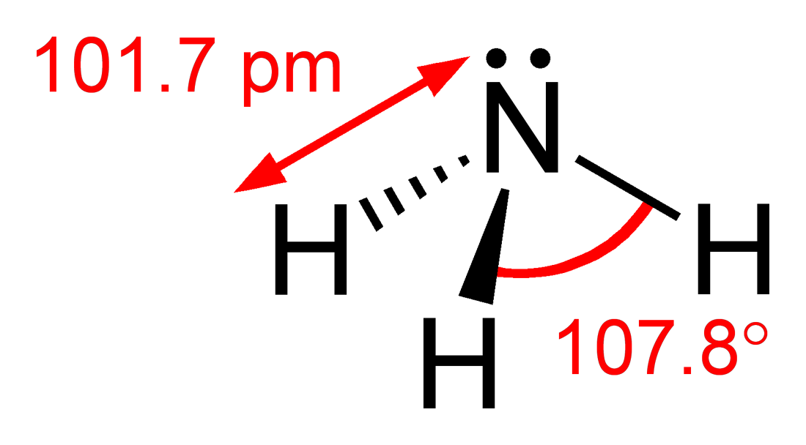
Why H-N-H bond angle in ammonia molecule are 106.45 or 107 degree??
Ammonium cation, methane, and ammonia are ALL sp3−hybridized, and to a first approximation ∠H−C−H, and ∠H−N−H ≅ 109.5∘. However, for ammonia, NH3, a lone pair of electrons is present on the nitrogen center, and this distorts the tetrahedral geometry that would otherwise operate for 4 pairs of electrons (of course there are 4 bonding pairs of electrons in ammonium, and methane, but only 3 bonding pairs of electrons in ammonia).
For ..NH3, the lone pair of electrons tends to compress the ∠H−N−H angles, and ∠H−N−H=104−5∘ rather than 109.5∘ observed for ammonium and methane. This effect is magnified by the fact that the ammonia lone pair is non-bonding, and thus closer to the nitrogen center, giving it (the lone pair) a disproproportionate influence on geometry.

Slide 38
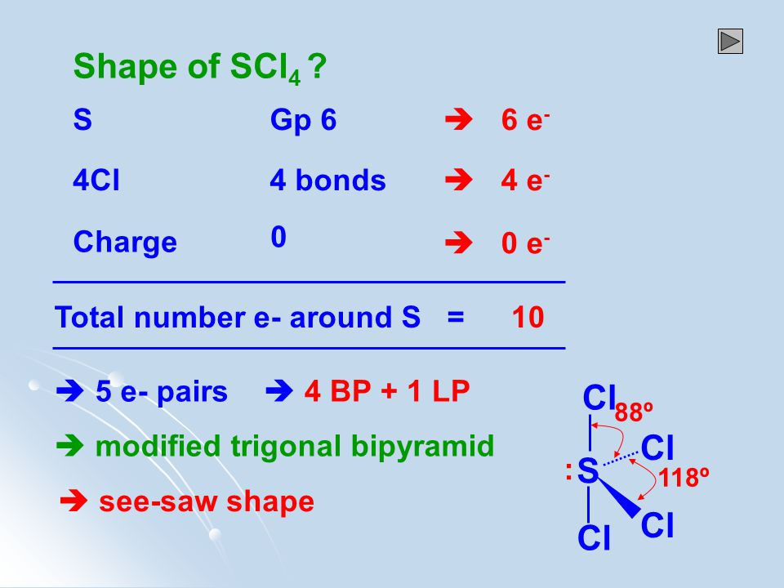
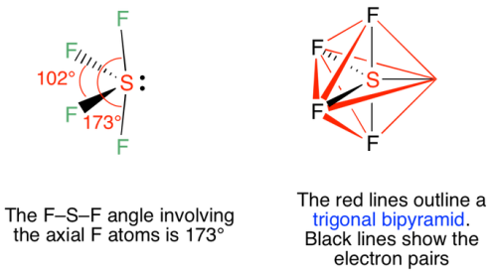
Structure of SF4

Slide 39
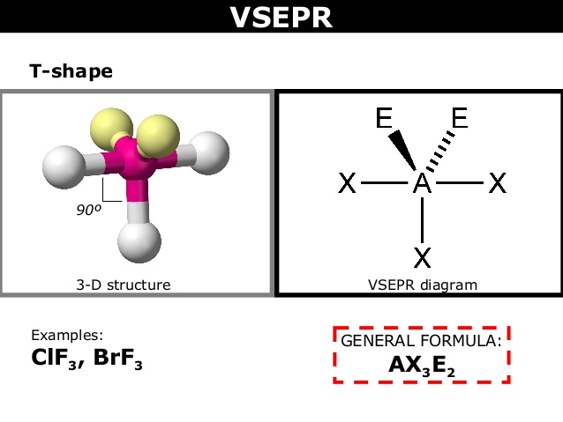
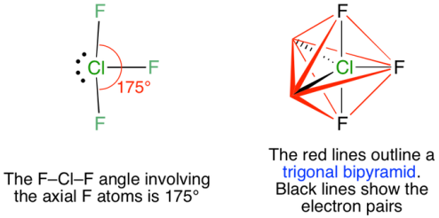
Structure of ClF3

Slide 40
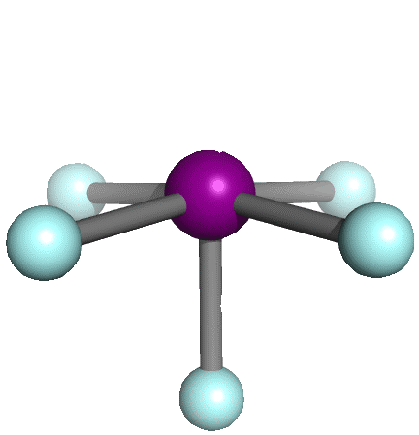
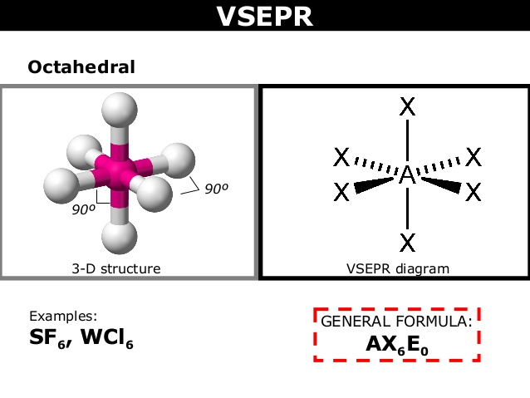


Draw the structure of SF6 and IF5
IF5

Slide 41

What is Molecular Orbital theory? Explain the MOT in H2 atom.
Molecular orbitals are obtained by combining the atomic orbitals on the atoms in the molecule. Consider the H2 molecule, for example. One of the molecular orbitals in this molecule is constructed by adding the mathematical functions for the two 1s atomic orbitals that come together to form this molecule. Another orbital is formed by subtracting one of these functions from the other, as shown in the figure below.
One of these orbitals is called a bonding molecular orbital because electrons in this orbital spend most of their time in the region directly between the two nuclei. It is called a sigma (Ʊ) molecular orbital because it looks like an s orbital when viewed along the H-H bond. Electrons placed in the other orbital spend most of their time away from the region between the two nuclei. This orbital is therefore an antibonding, or sigma star (*), molecular orbital.

Slide 42

Molecular orbital theory
The bonding molecular orbital concentrates electrons in the region directly between the two nuclei. Placing an electron in this orbital therefore stabilizes the H2 molecule. Since the * antibonding molecular orbital forces the electron to spend most of its time away from the area between the nuclei, placing an electron in this orbital makes the molecule less stable.
Electrons are added to molecular orbitals, one at a time, starting with the lowest energy molecular orbital. The two electrons associated with a pair of hydrogen atoms are placed in the lowest energy, or bonding, molecular orbital, as shown in the figure below. This diagram suggests that the energy of an H2 molecule is lower than that of a pair of isolated atoms. As a result, the H2 molecule is more stable than a pair of isolated atoms.

Slide 43


Slide 44

Molecular orbital theory of O2
O2
Atomic orbital Molecular orbital Atomic orbital

